Slide 1
Packages used (visualisation specific)
Plotly
Dash (by plotly)
networkX

Slide 2
Slides about how to built

Slide 3
ANITA TREND ANALYSIS
Tab1: Descriptives
Tab2: Network graph
Tab3: Specifics

Slide 4
ANITA TREND ANALYSIS
Tab1: Descriptives
Tab2: Network graph
Tab3: Specifics
Give information about the data (market level)
Filter:
Period selection
Market selection
Data
# Unique vendors (bar chart per market + total)
# Unique products (bar chart per market + total)
# overlapping pgp / names across markets (textual)
Some examples (textual)

Slide 5
ANITA TREND ANALYSIS
Tab1: Descriptives
Tab2: Network graph
Tab3: Specifics
Show network graph for selection
Filter:
Market selection
Select name of vendors from overlapping PGP or name
Show Network graph:
Hover information
Simple full name
ClickOn information
Content of the dataset (table format)
Simple descriptives (example: how many extraction dates in dataset)

Slide 6
ANITA TREND ANALYSIS
Tab1:Descriptives
Tab2: Network graph
Tab3: Specifics
Subtab1: Product
Subtab2: Vendor
Show specific graphs for selection (product & vendor level)
Filter:
Market selection
Period selection
Select name of vendors or products
Information shown:
Trend of sales (if sales in dataset, line plot)
Information (score, shipping etc., textual)

Slide 7
Screenshots

Slide 8
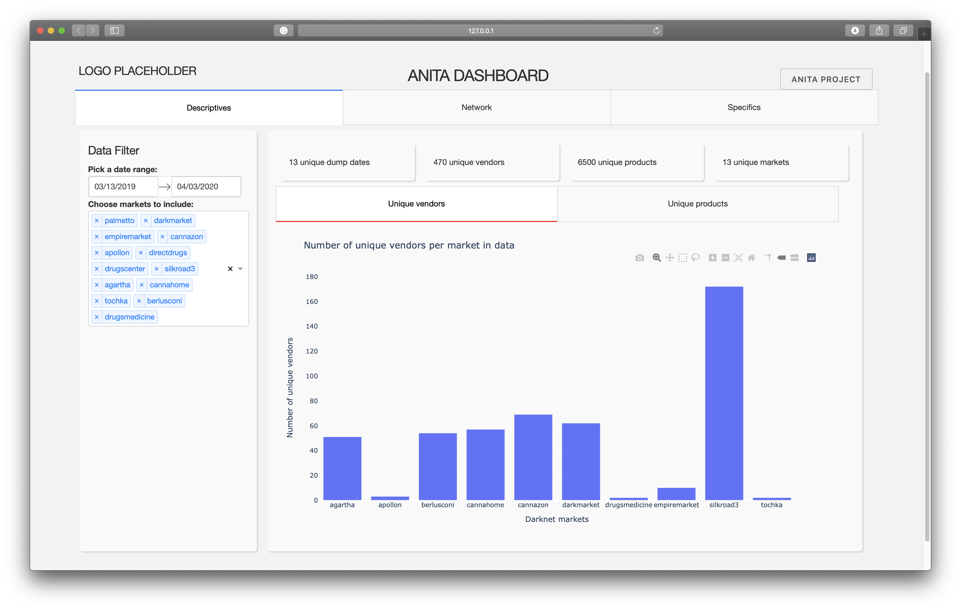

Slide 9
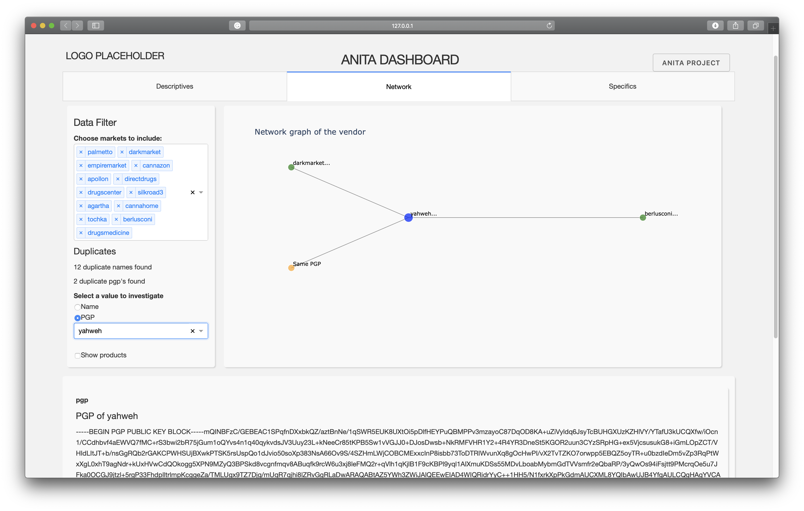

Slide 10
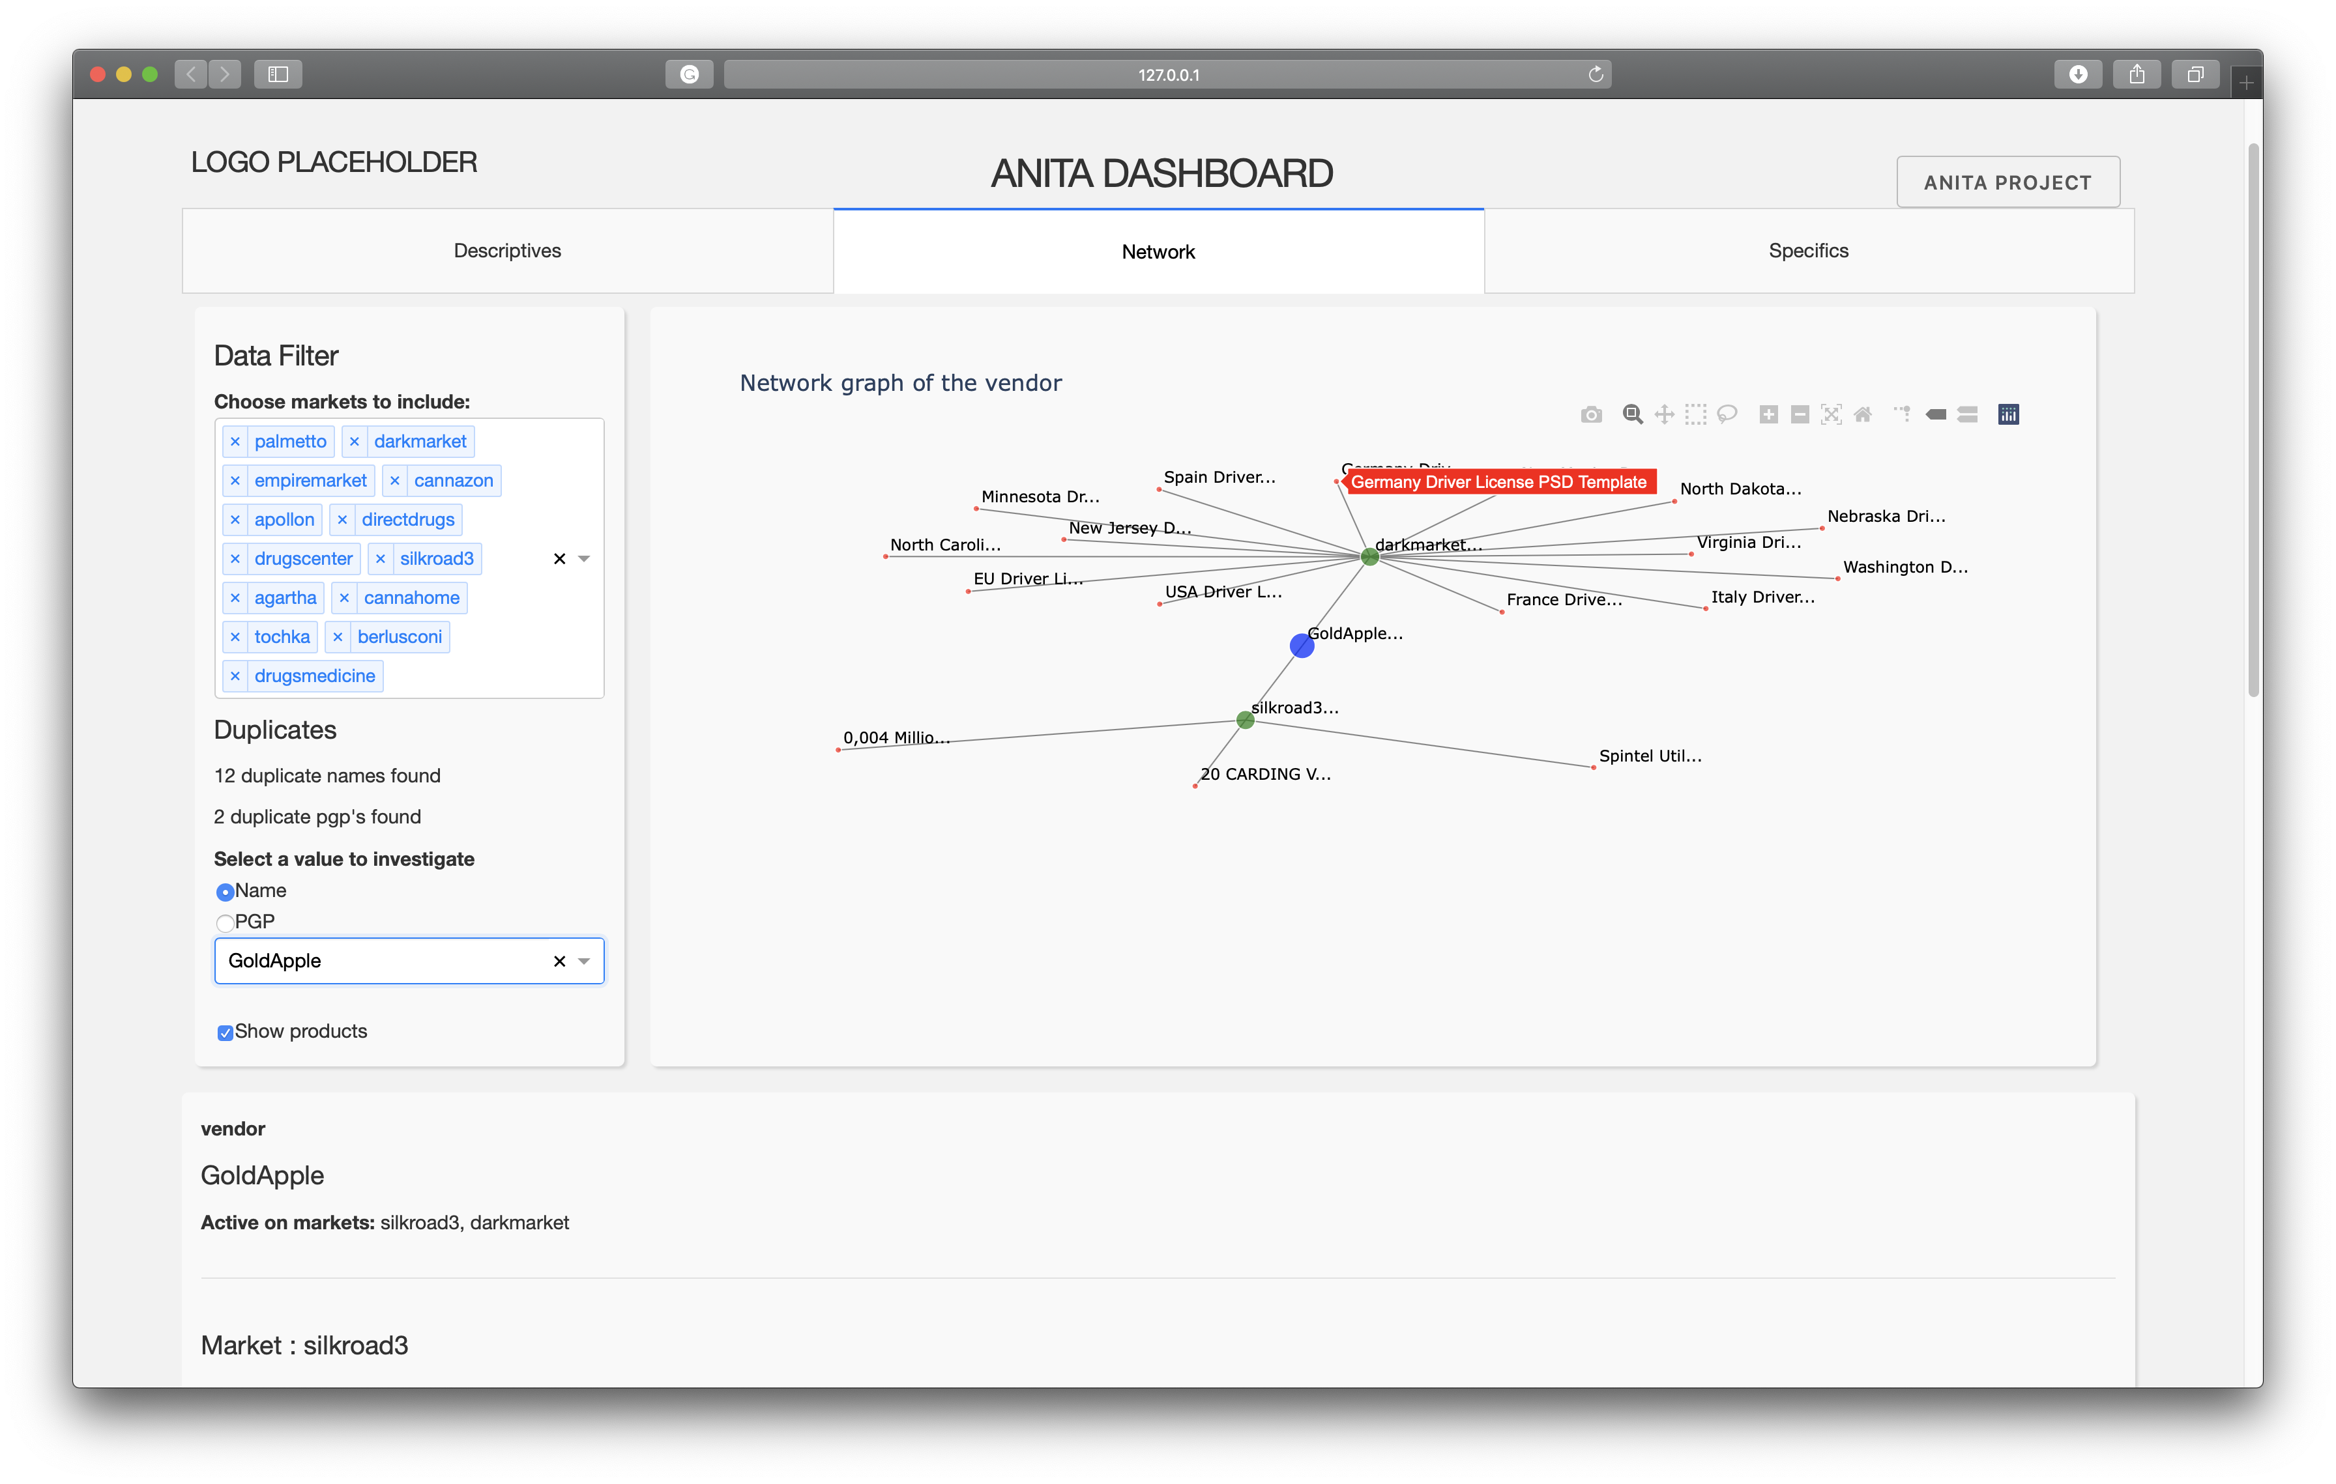

Slide 11
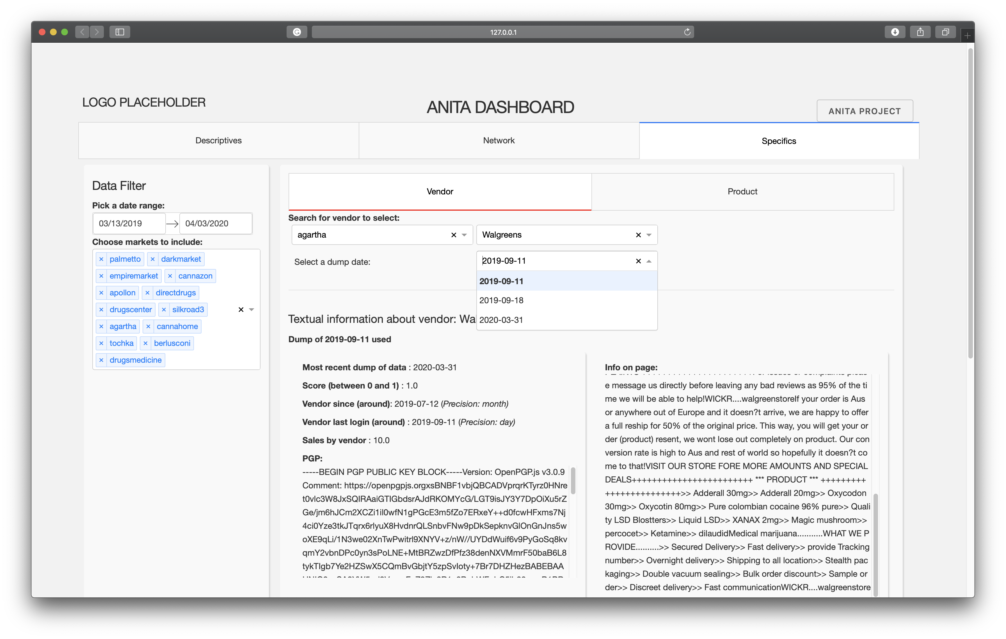

Slide 12
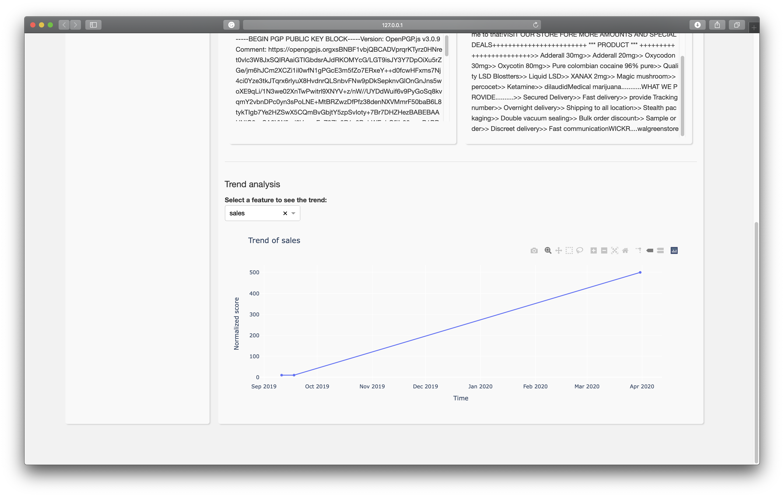

Slide 13
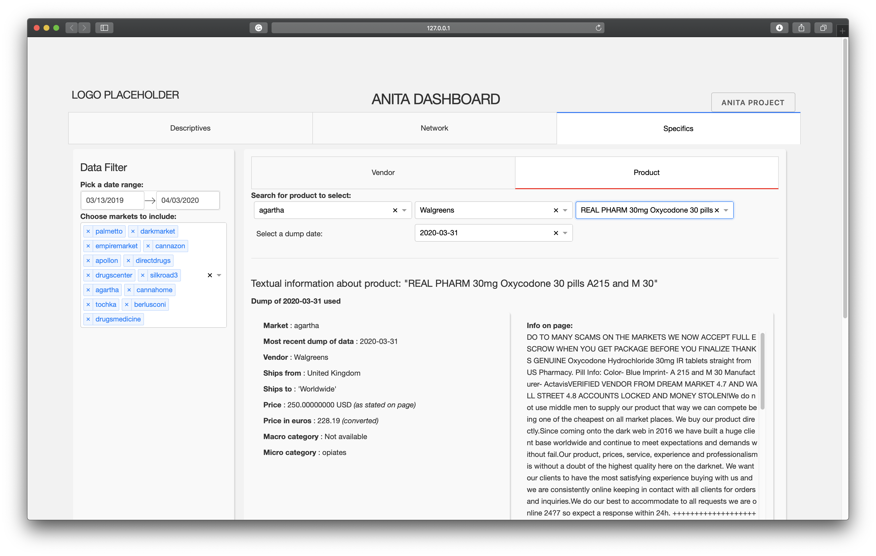

Slide 14
